Slide 1
INTRODUCTION TO OPERATING SYSTEM CS-222T

Slide 2
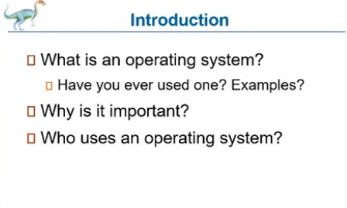

Slide 3
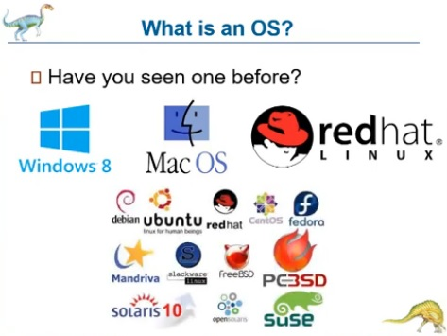

Slide 4
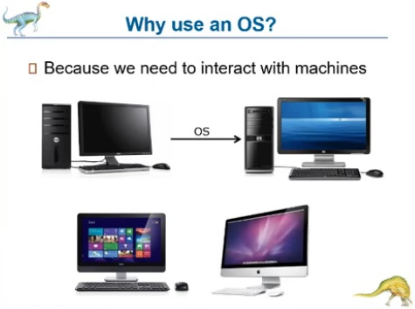

Slide 5
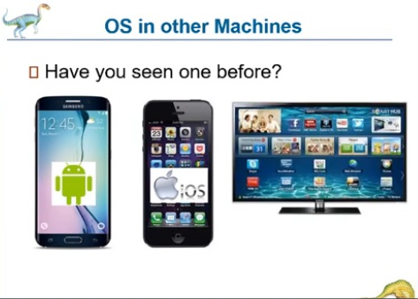

Slide 6
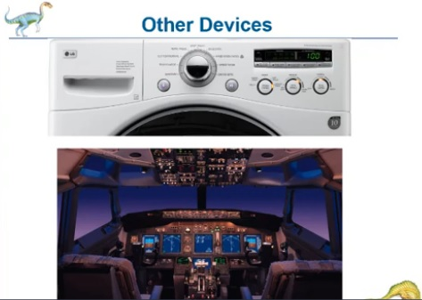

Slide 7
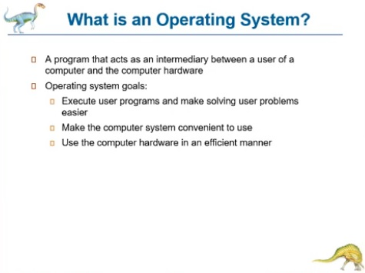

Slide 8
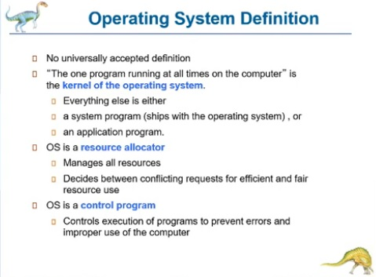

Slide 9
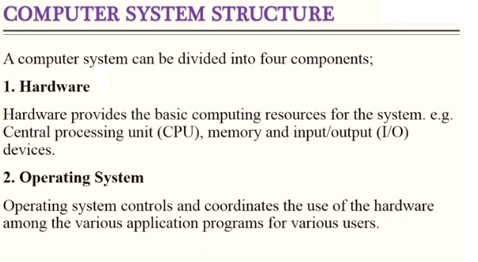

Slide 10
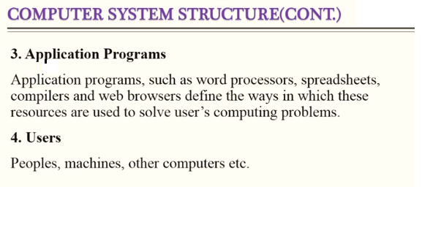

Slide 11
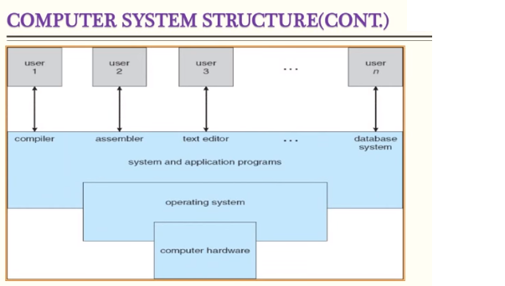

Slide 12
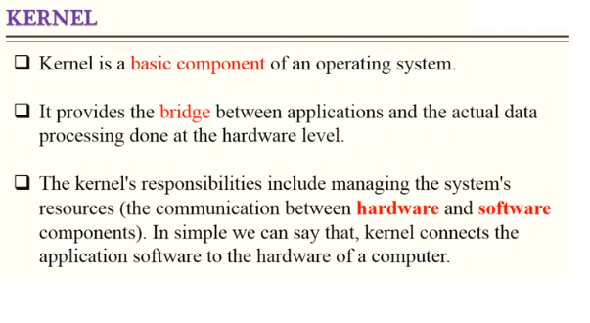

Slide 13
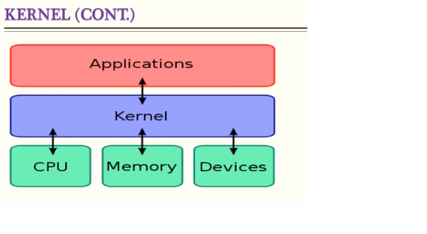

Slide 14
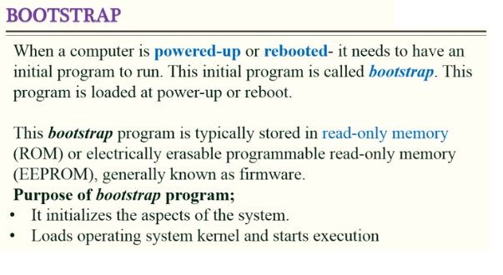

Slide 15
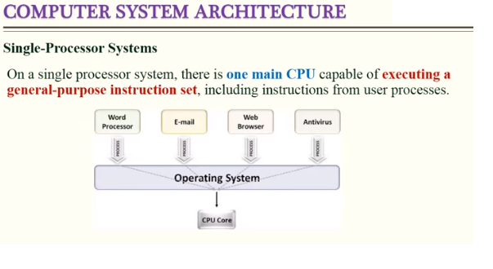

Slide 16
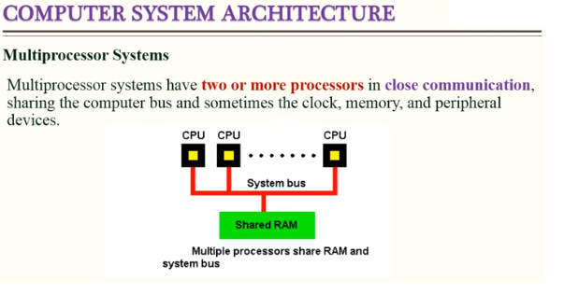

Slide 17
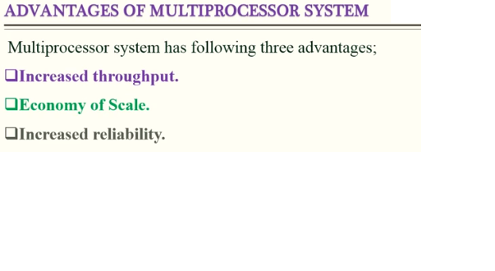

Slide 18
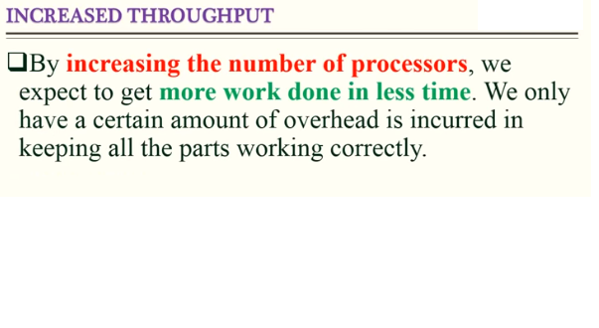

Slide 19
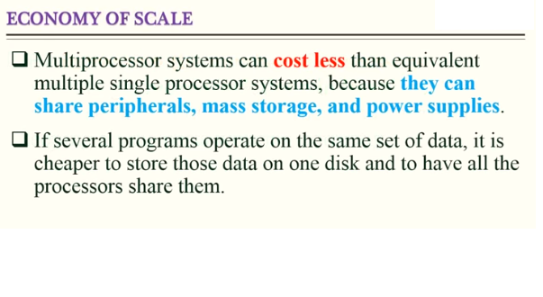

Slide 20
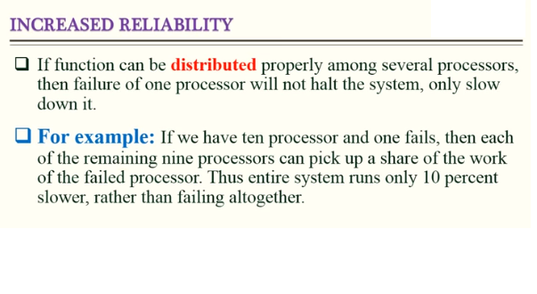

Slide 21
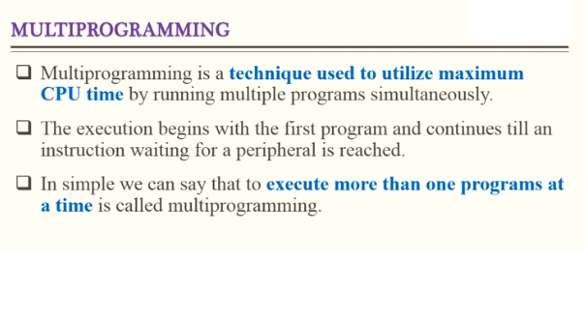

Slide 22
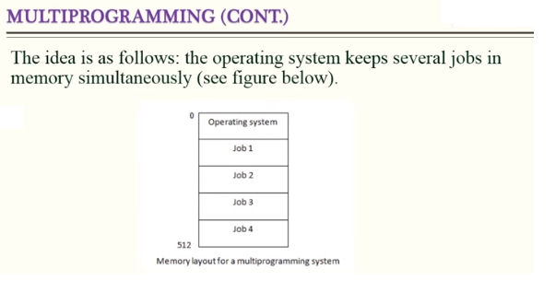

Slide 23
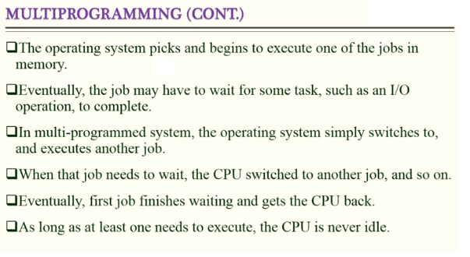

Slide 24
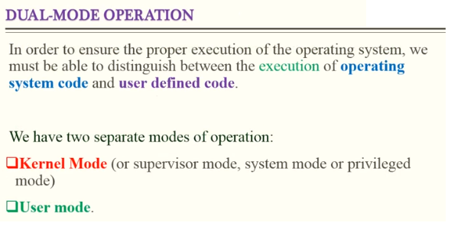

Slide 25
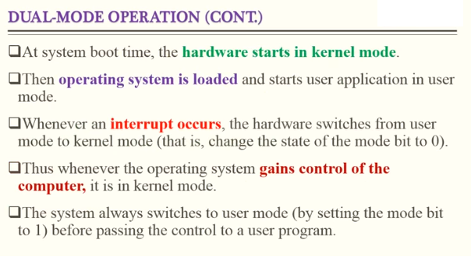

Slide 26
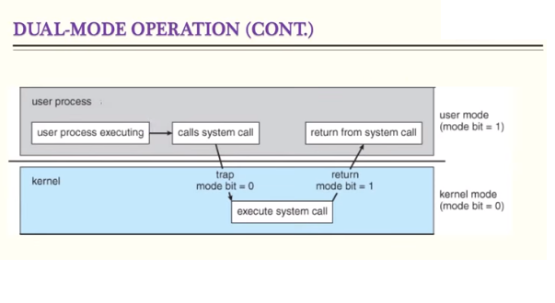

Slide 27
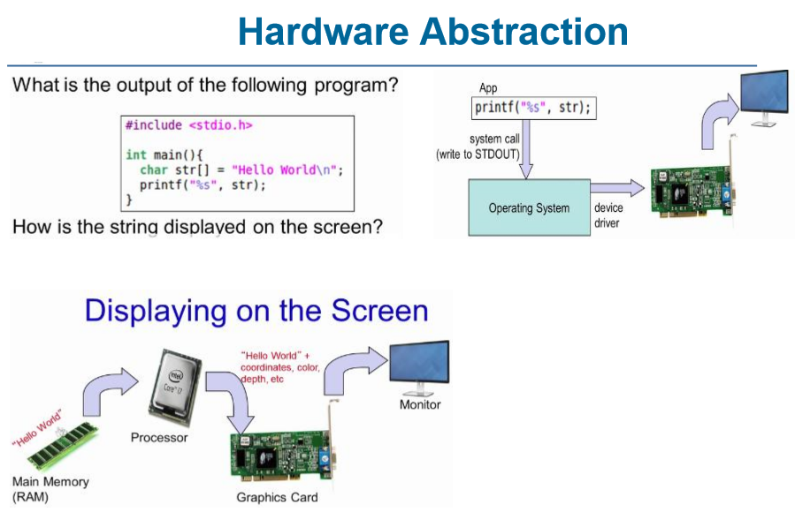

Slide 28
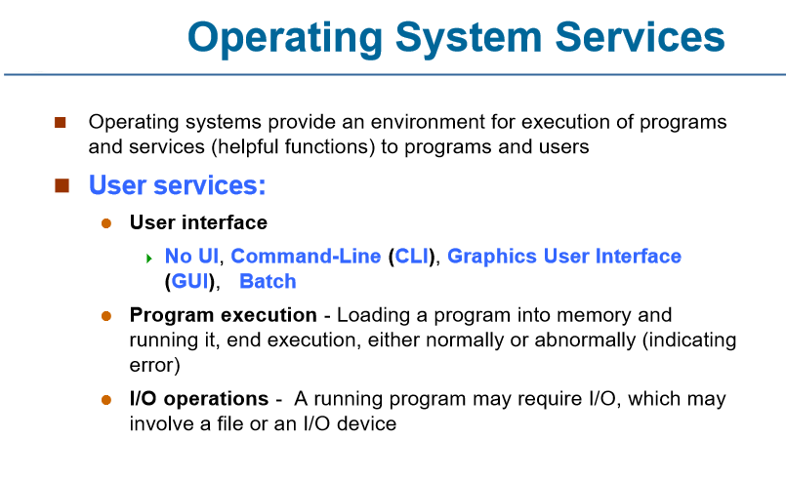

Slide 29
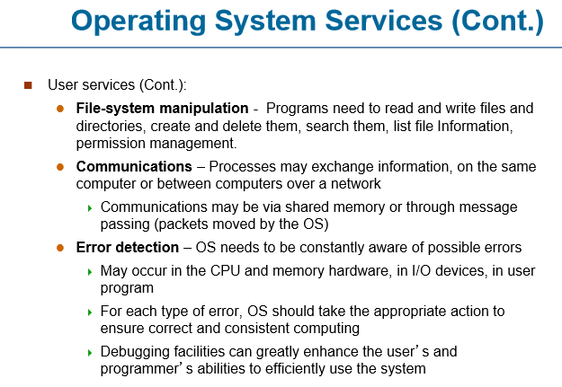

Slide 30
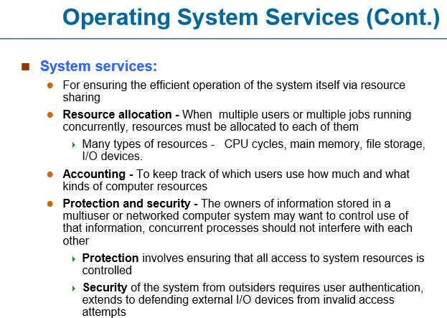

Slide 31
System Calls
Systems calls is a request made by the user program to the operating system in order to get any kind of services.
Typically written in a high-level language (C or C++)

Slide 32
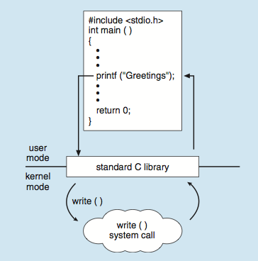
Standard C Library Example
C program invoking printf() library call, which calls write() system call

Slide 33
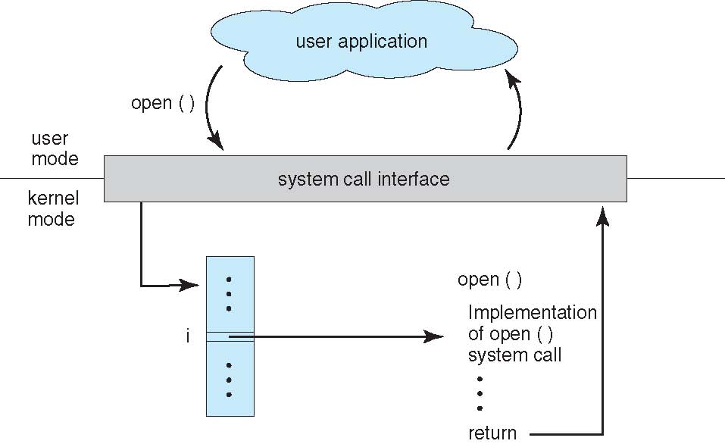
System Call – OS Relationship

Slide 34
Types of System Calls
Process control
create process, terminate process
end, abort
load, execute
wait for time
allocate and free memory
File management
create file, delete file
open, close file
read, write
Device management
request device, release device
read, write
logically attach or detach devices

Slide 35
Types of System Calls
Information maintenance
get time or date, set time or date
get system data, set system data
get and set process, file, or device attributes
Communications
create, delete communication connection
send, receive messages
transfer status information

Slide 36
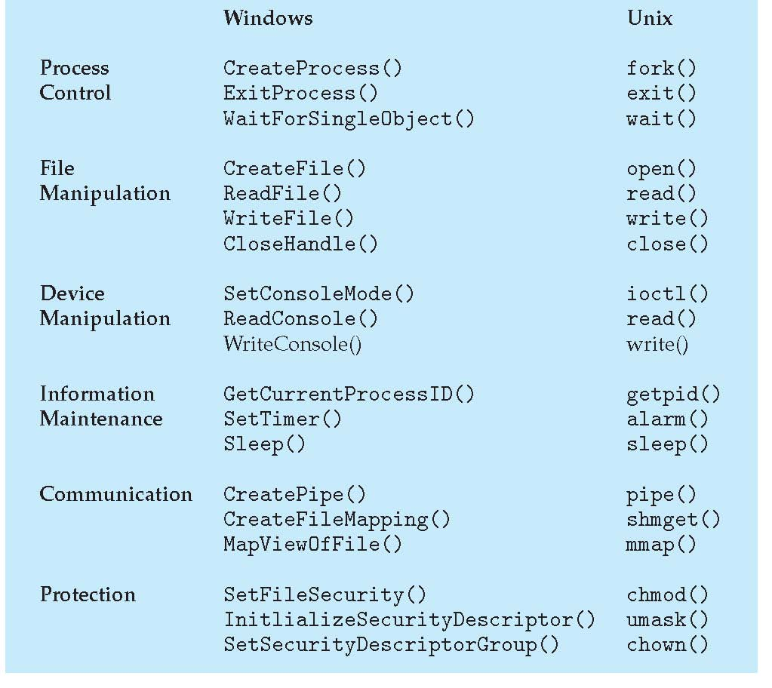
Examples of Windows and Unix System Calls

